Slide 1
Final Project ICSDS
Ramish (mrj8522), Iris (il2282), Jo (ajt9668)

Slide 2
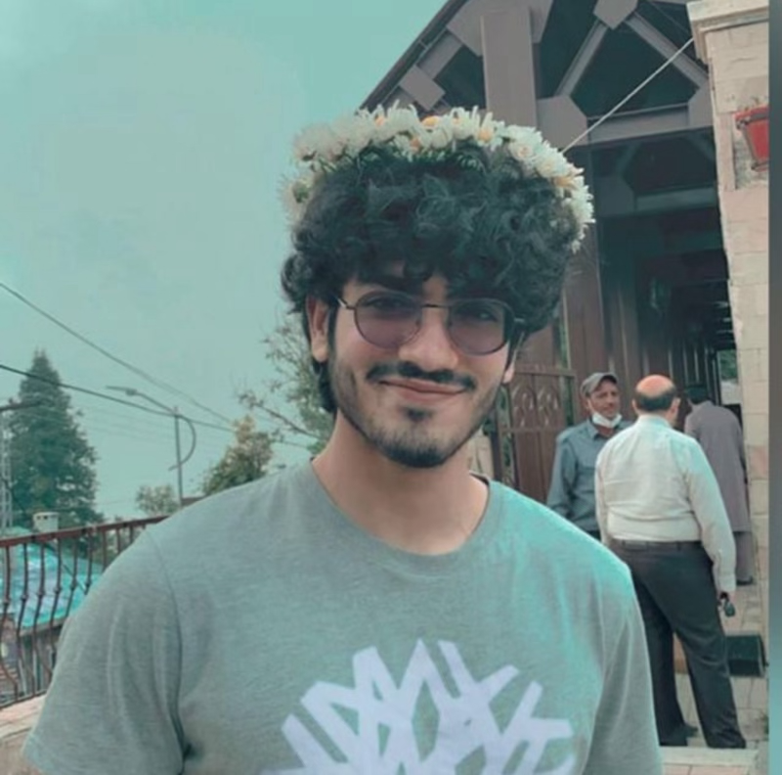
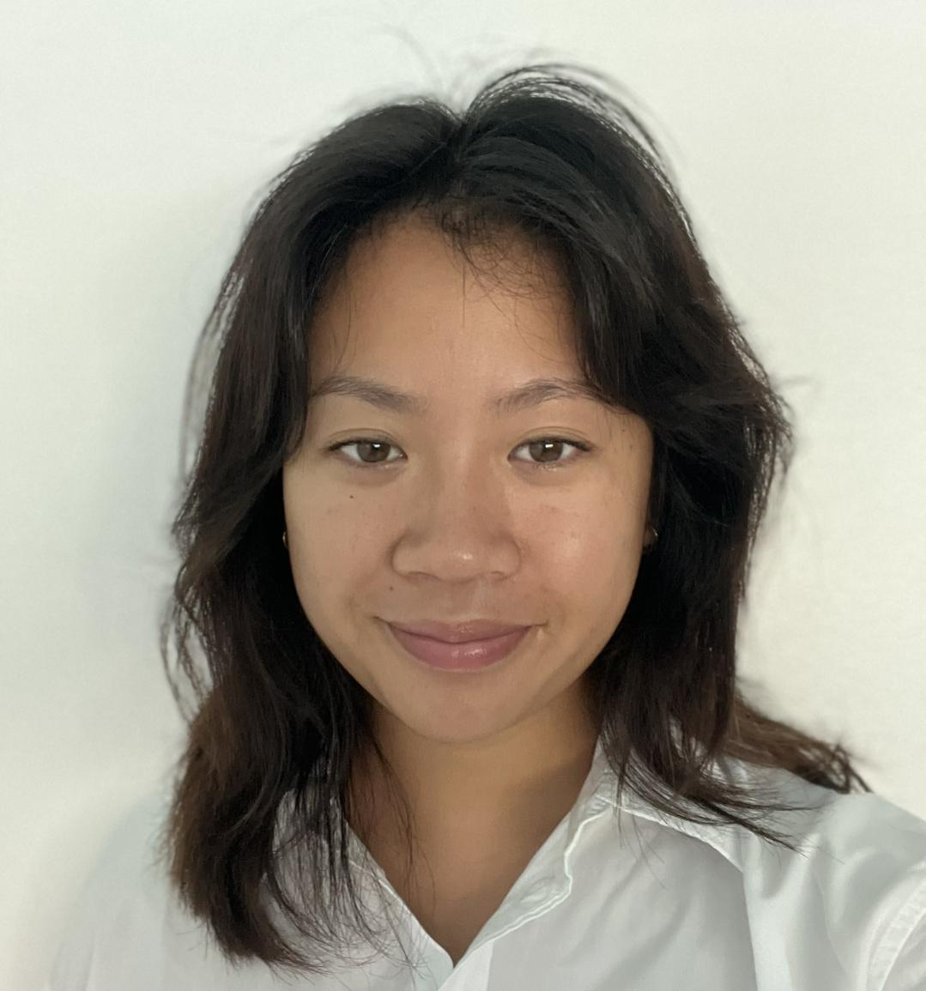
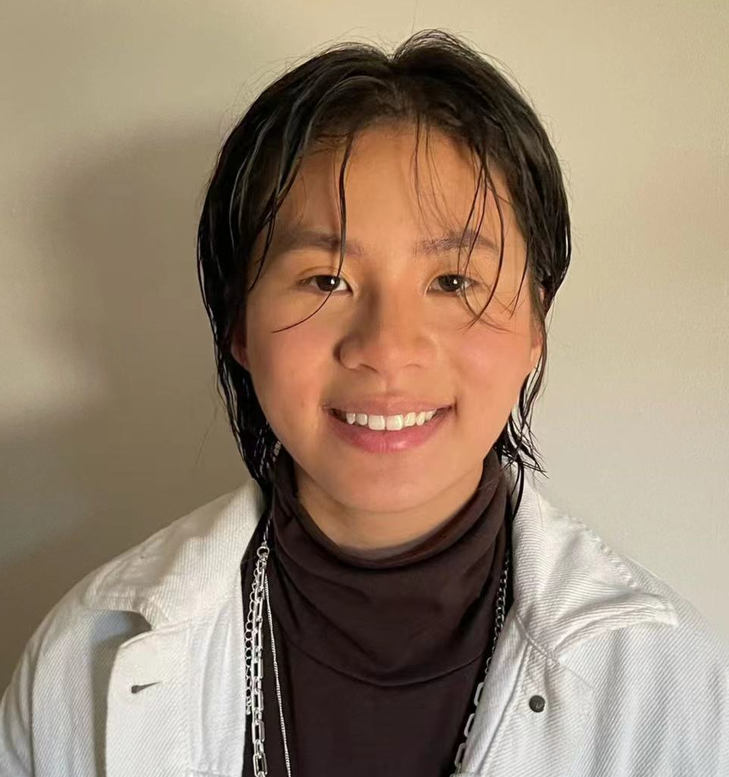
Overview
Introduction
Discussion
Topics
Demo of the App
Analysis
Ramish Jalil
Jo Tran
Iris Liu

Slide 3
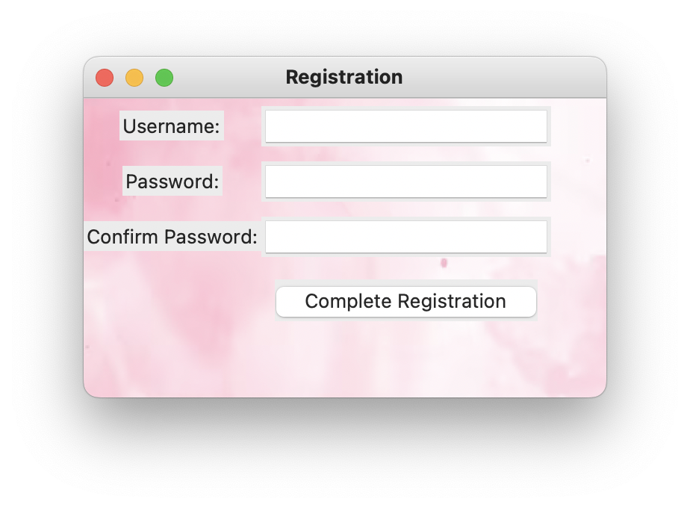
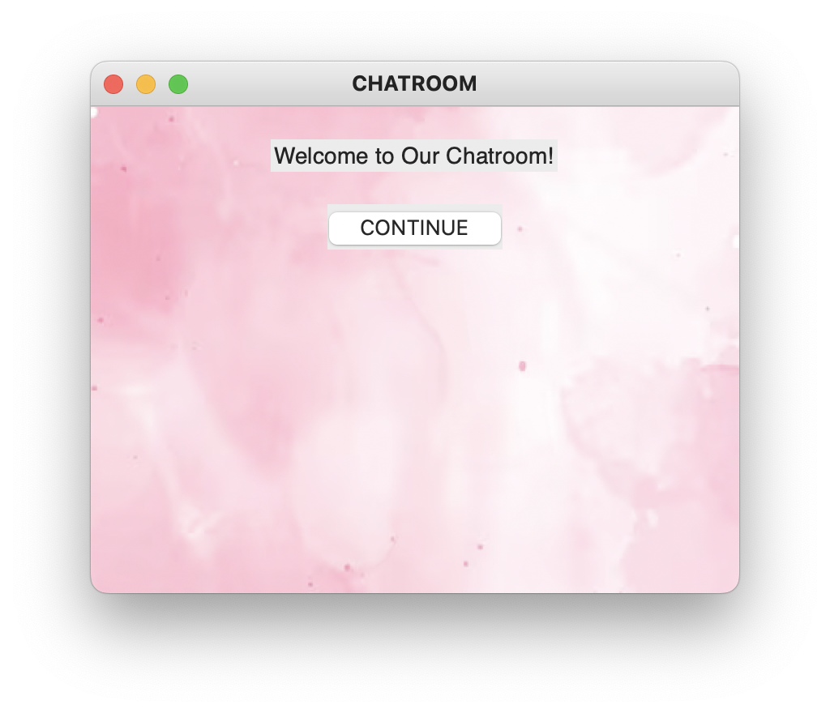
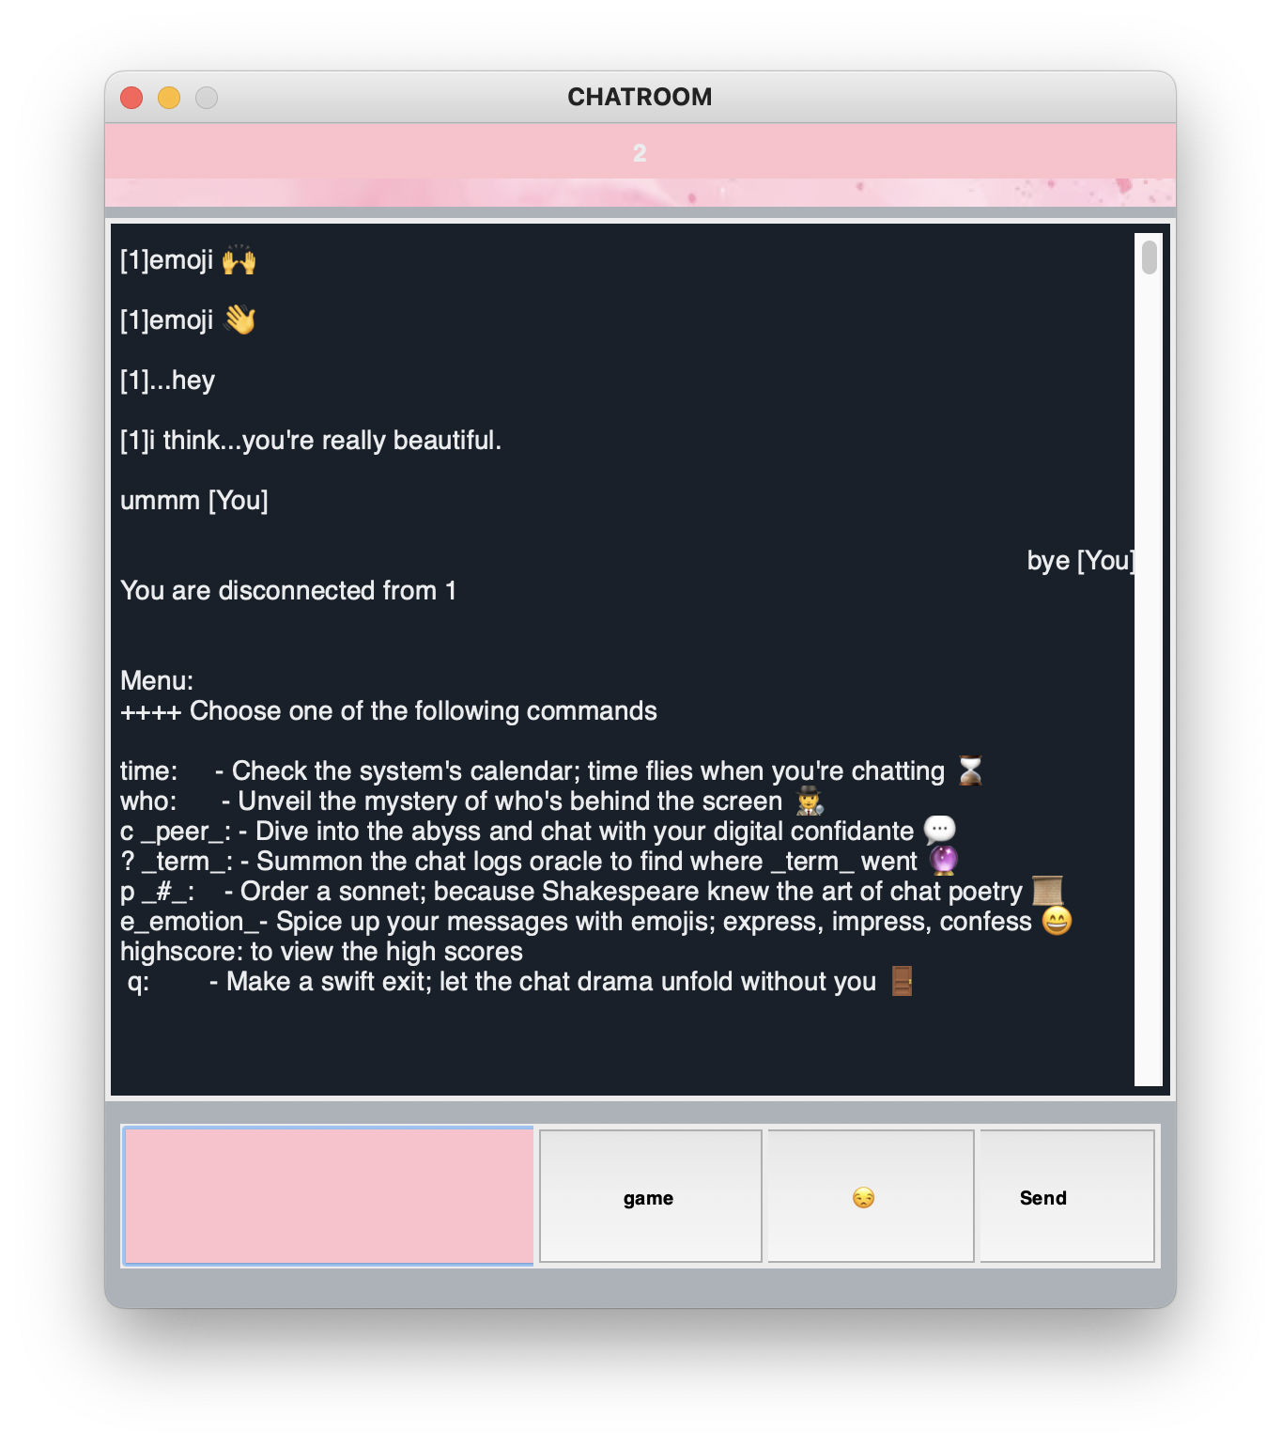
Introduction- what we did
Our GUI
Inserted background image
Added Emoji Library
Added Game button
Game
Added sound
Send highscore feature
Encryption
Fernet Encryption
Notes:
Your introduction should clearly explain your project and your motivation for creating it. This will help your audience understand the context of your work and why it is important. You should strive to be clear and concise in your delivery to maximize the impact of your message.

Slide 4
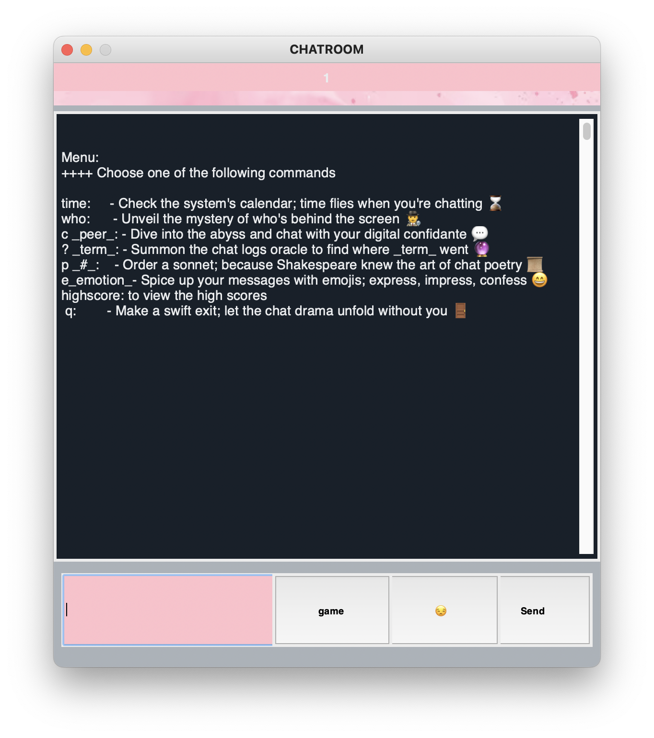
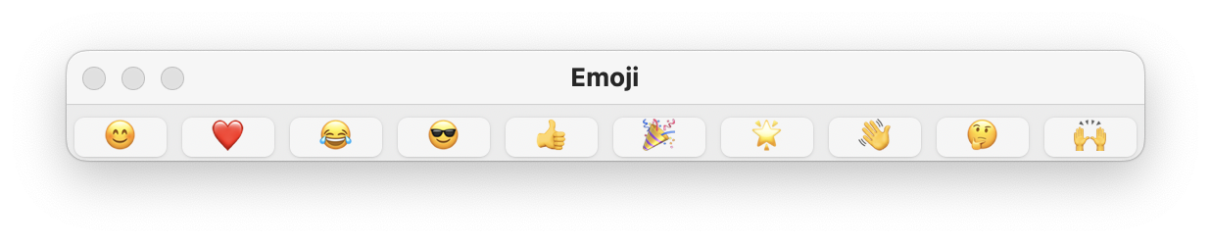
Main Window
Commands
Time
Poetry
New: High Score
Buttons
Emoji Library
Game

Slide 5
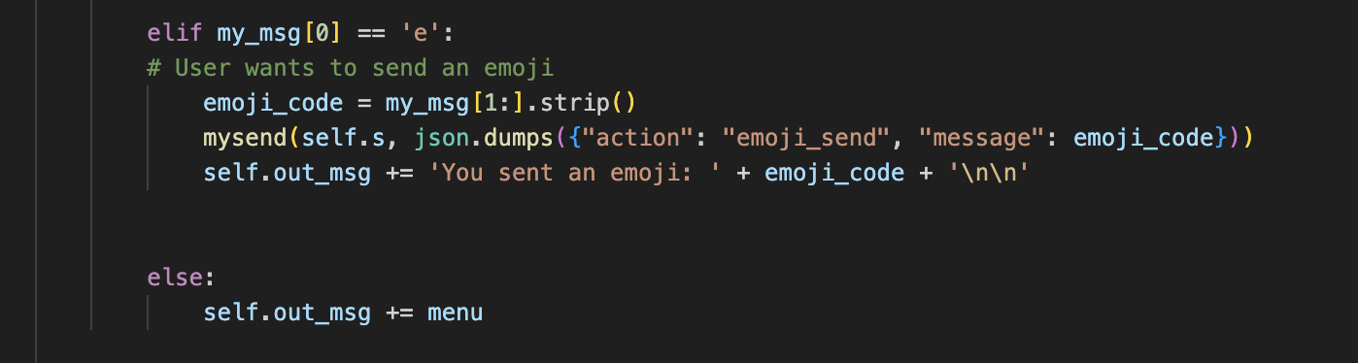
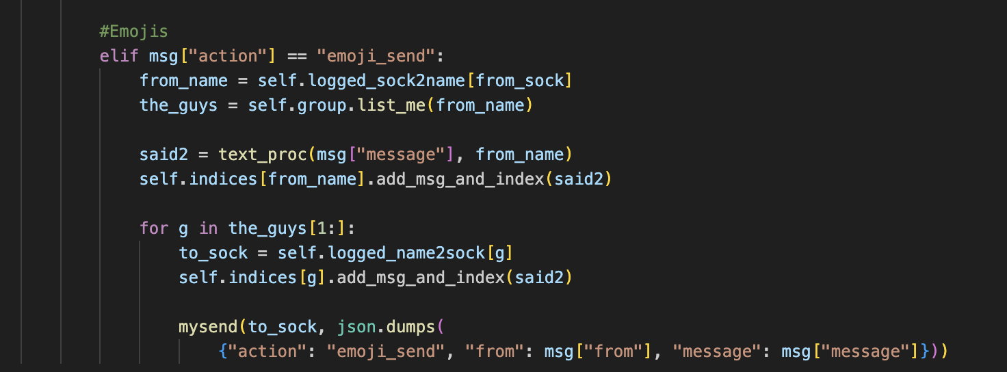
Emoji Code
client_state_machine.py
chat_server.py

Slide 6
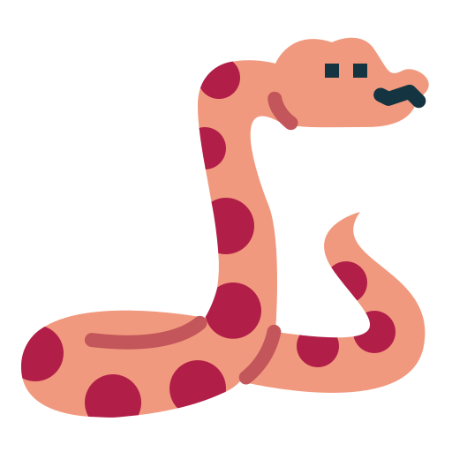
Game: Snakes

Slide 7
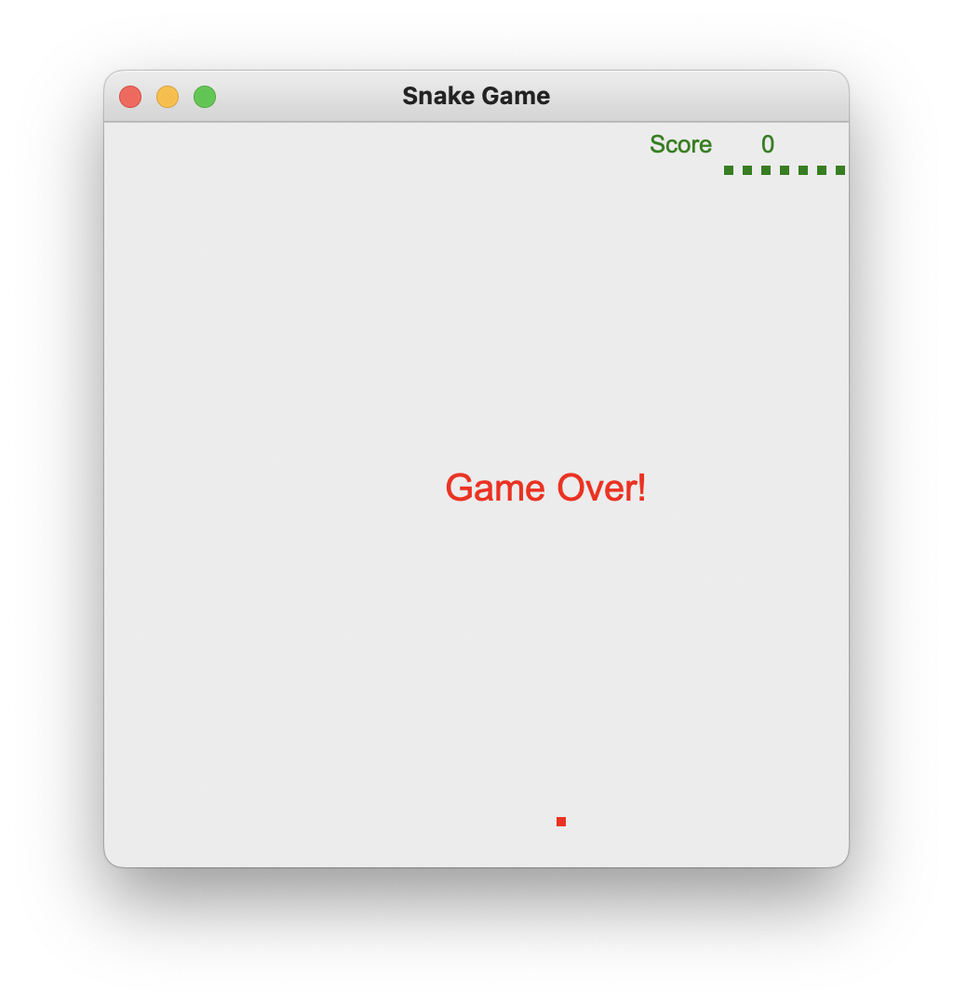
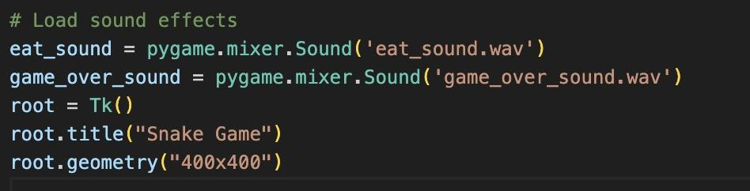
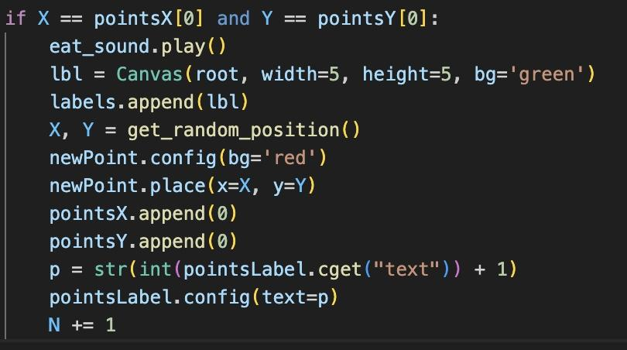
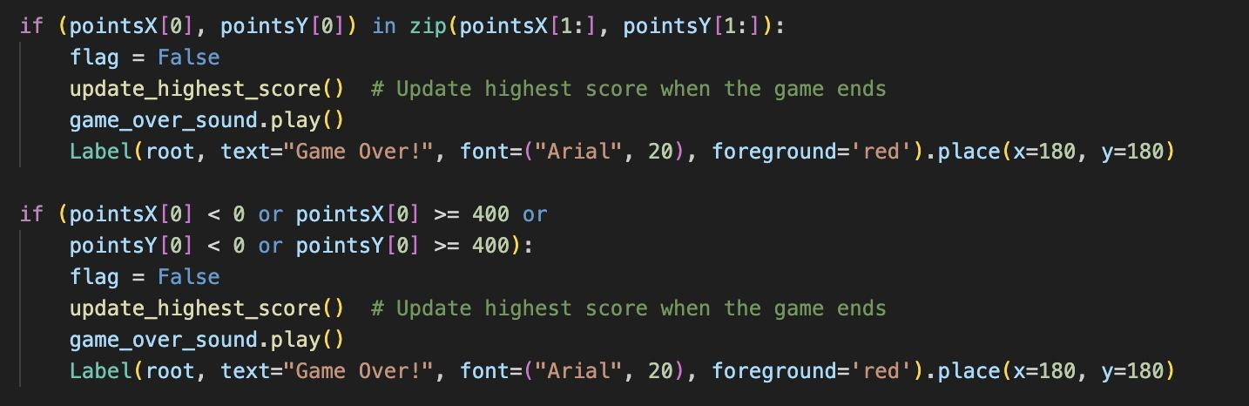
Snakes 🐍: Audio
Improvements:
Audio
Biting
Game Over

Slide 8
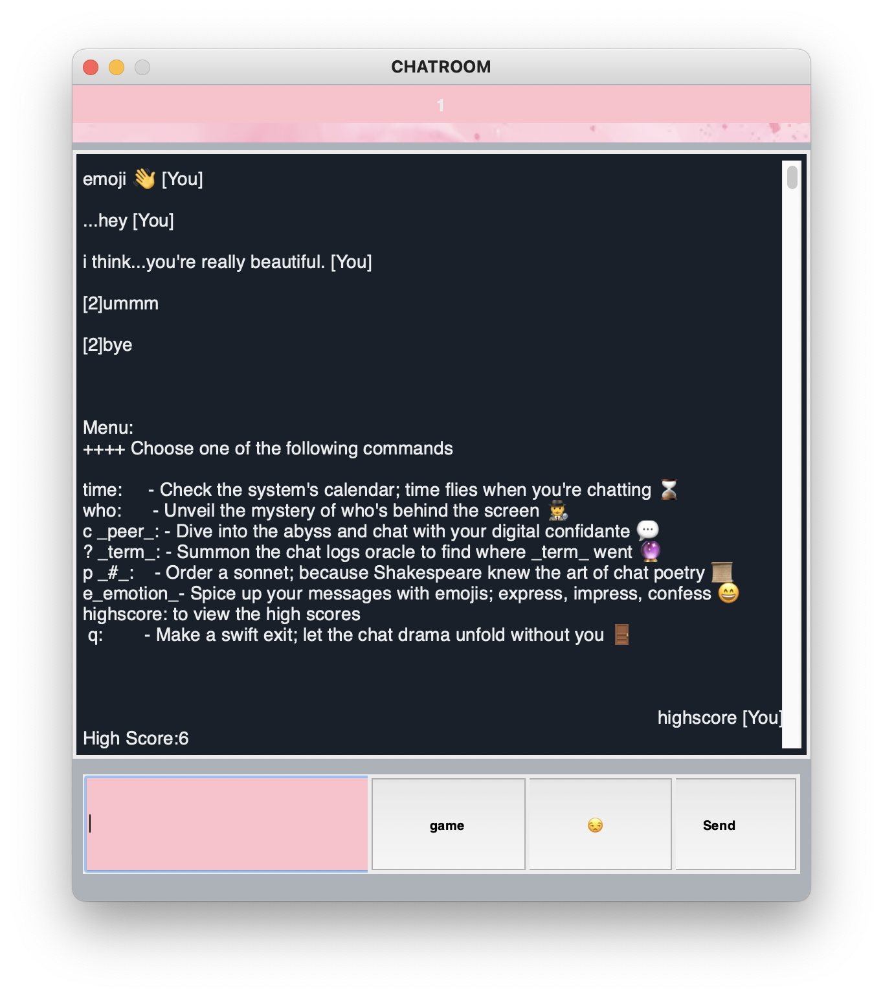
Snakes 🐍: High Score
High Score
score.txt
Update the first line
Where Implemented:
snake.py
chat_server.py
Client_state_machine.py
Indexer.py and indexer_good.py

Slide 9
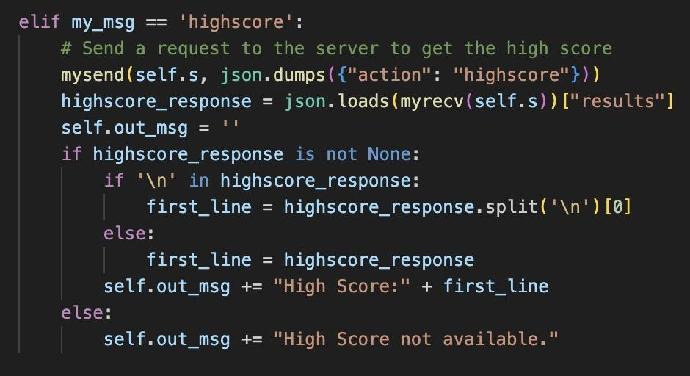
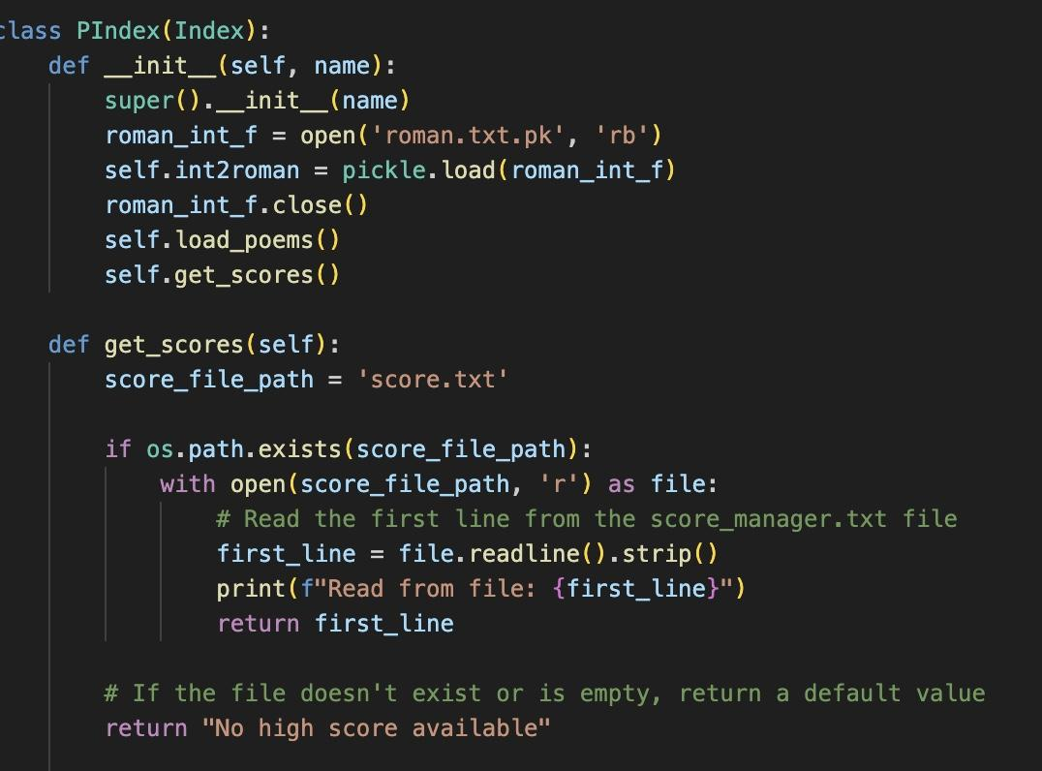
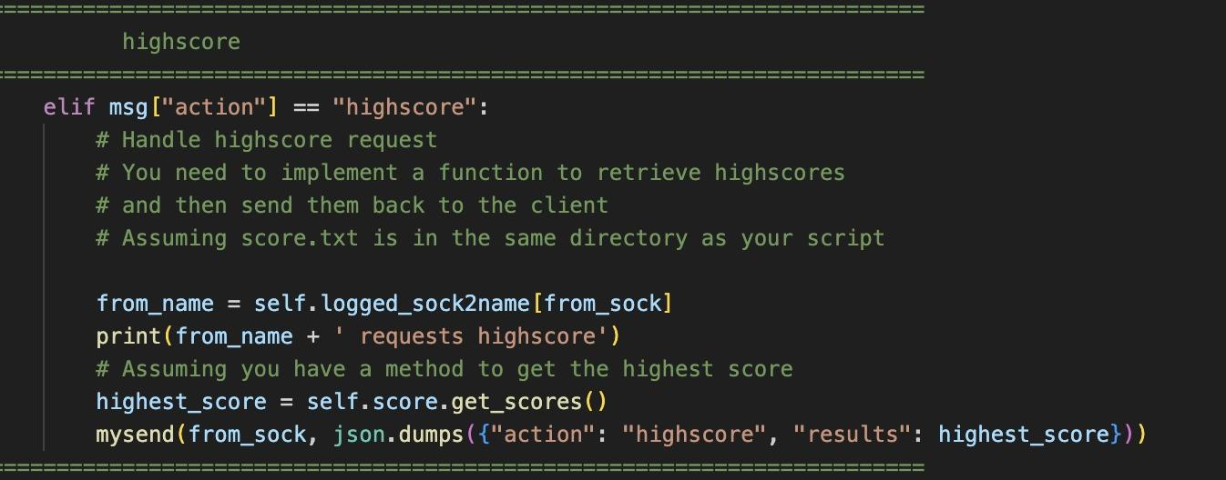
Snakes 🐍: Implementation
chat_server
Indexer and indexer_good
client_state_machine

Slide 10
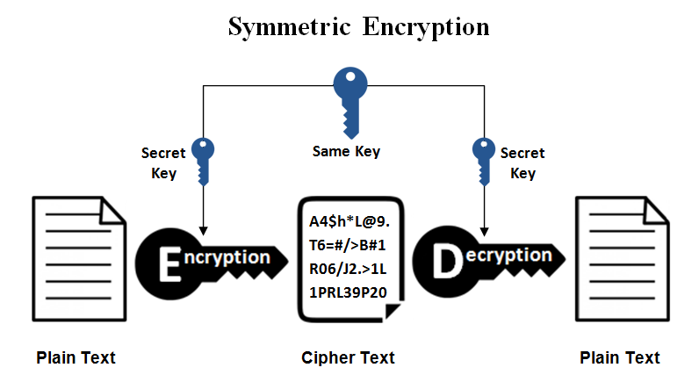
Fernet Encryption
Symmetric Encryption
Uses the same key to both encrypt and decrypt the original message.
Both parties need a shared symmetric key to set up a secure channel.

Slide 11
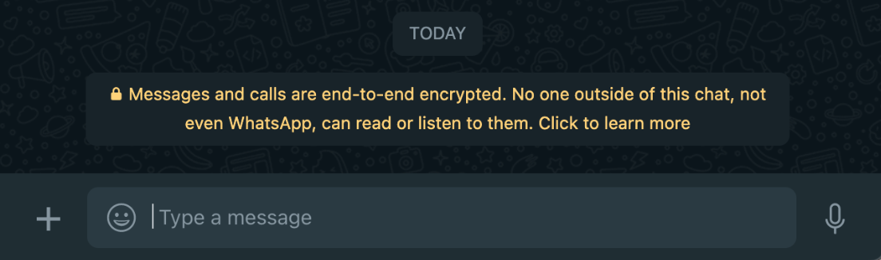
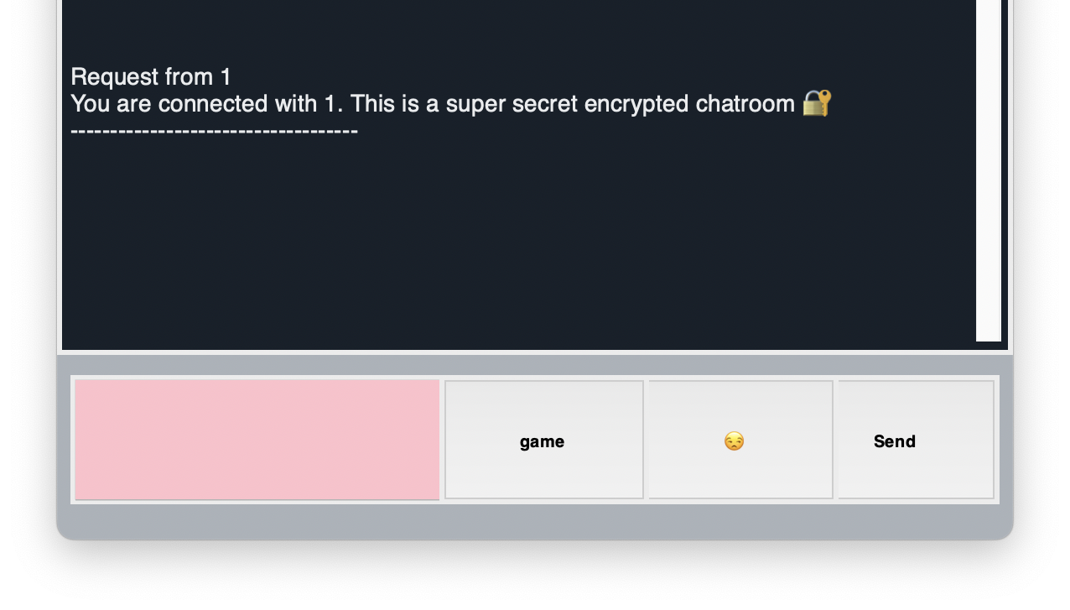
Fernet Encryption
Authenticated Encryption:
Ensures the integrity and authenticity of the encrypted data.
Includes a tag that allows the recipient to verify that the data has not been tampered with
Whatsapp
Our Chat System

Slide 12
Chat System Demonstration

Slide 13
Analysis
Making the code more modular and readable
Add more emojis
Add more game options for people to play
Add a speak-to-chat feature
Hit Enter instead of actual clicking on send
Add filter in the chat
Adding an option to change the background of the chatroom
Notes:
Your analysis should reflect on the development of your project. This may include discussing the organization of your code, the classes you defined, or possible areas for improvement. By providing this analysis, you can demonstrate your expertise and thoughtfulness as a developer.

Slide 14
Challenges:
GUI
Whenever a user sent a message, the menu would reprint
If one person sent a message, it would not show up in their chatroom, only to the person they sent it to.
Button formatting since we added additional buttons
Snake
First snake game could not work with tkinter, so rewrote
Figure out what implement server options snake can use
Implement Score

Slide 15
Evaluation
Each component will be evaluated based on the following criteria (clearance, impressiveness, and relevance to the project):
Clearance: how easy it is to understand your presentation
Impressiveness: how well you showcase your skills and expertise
Relevance: how well your presentation aligns with the objectives of your project

Slide 16
Thank you!

